Slide 1
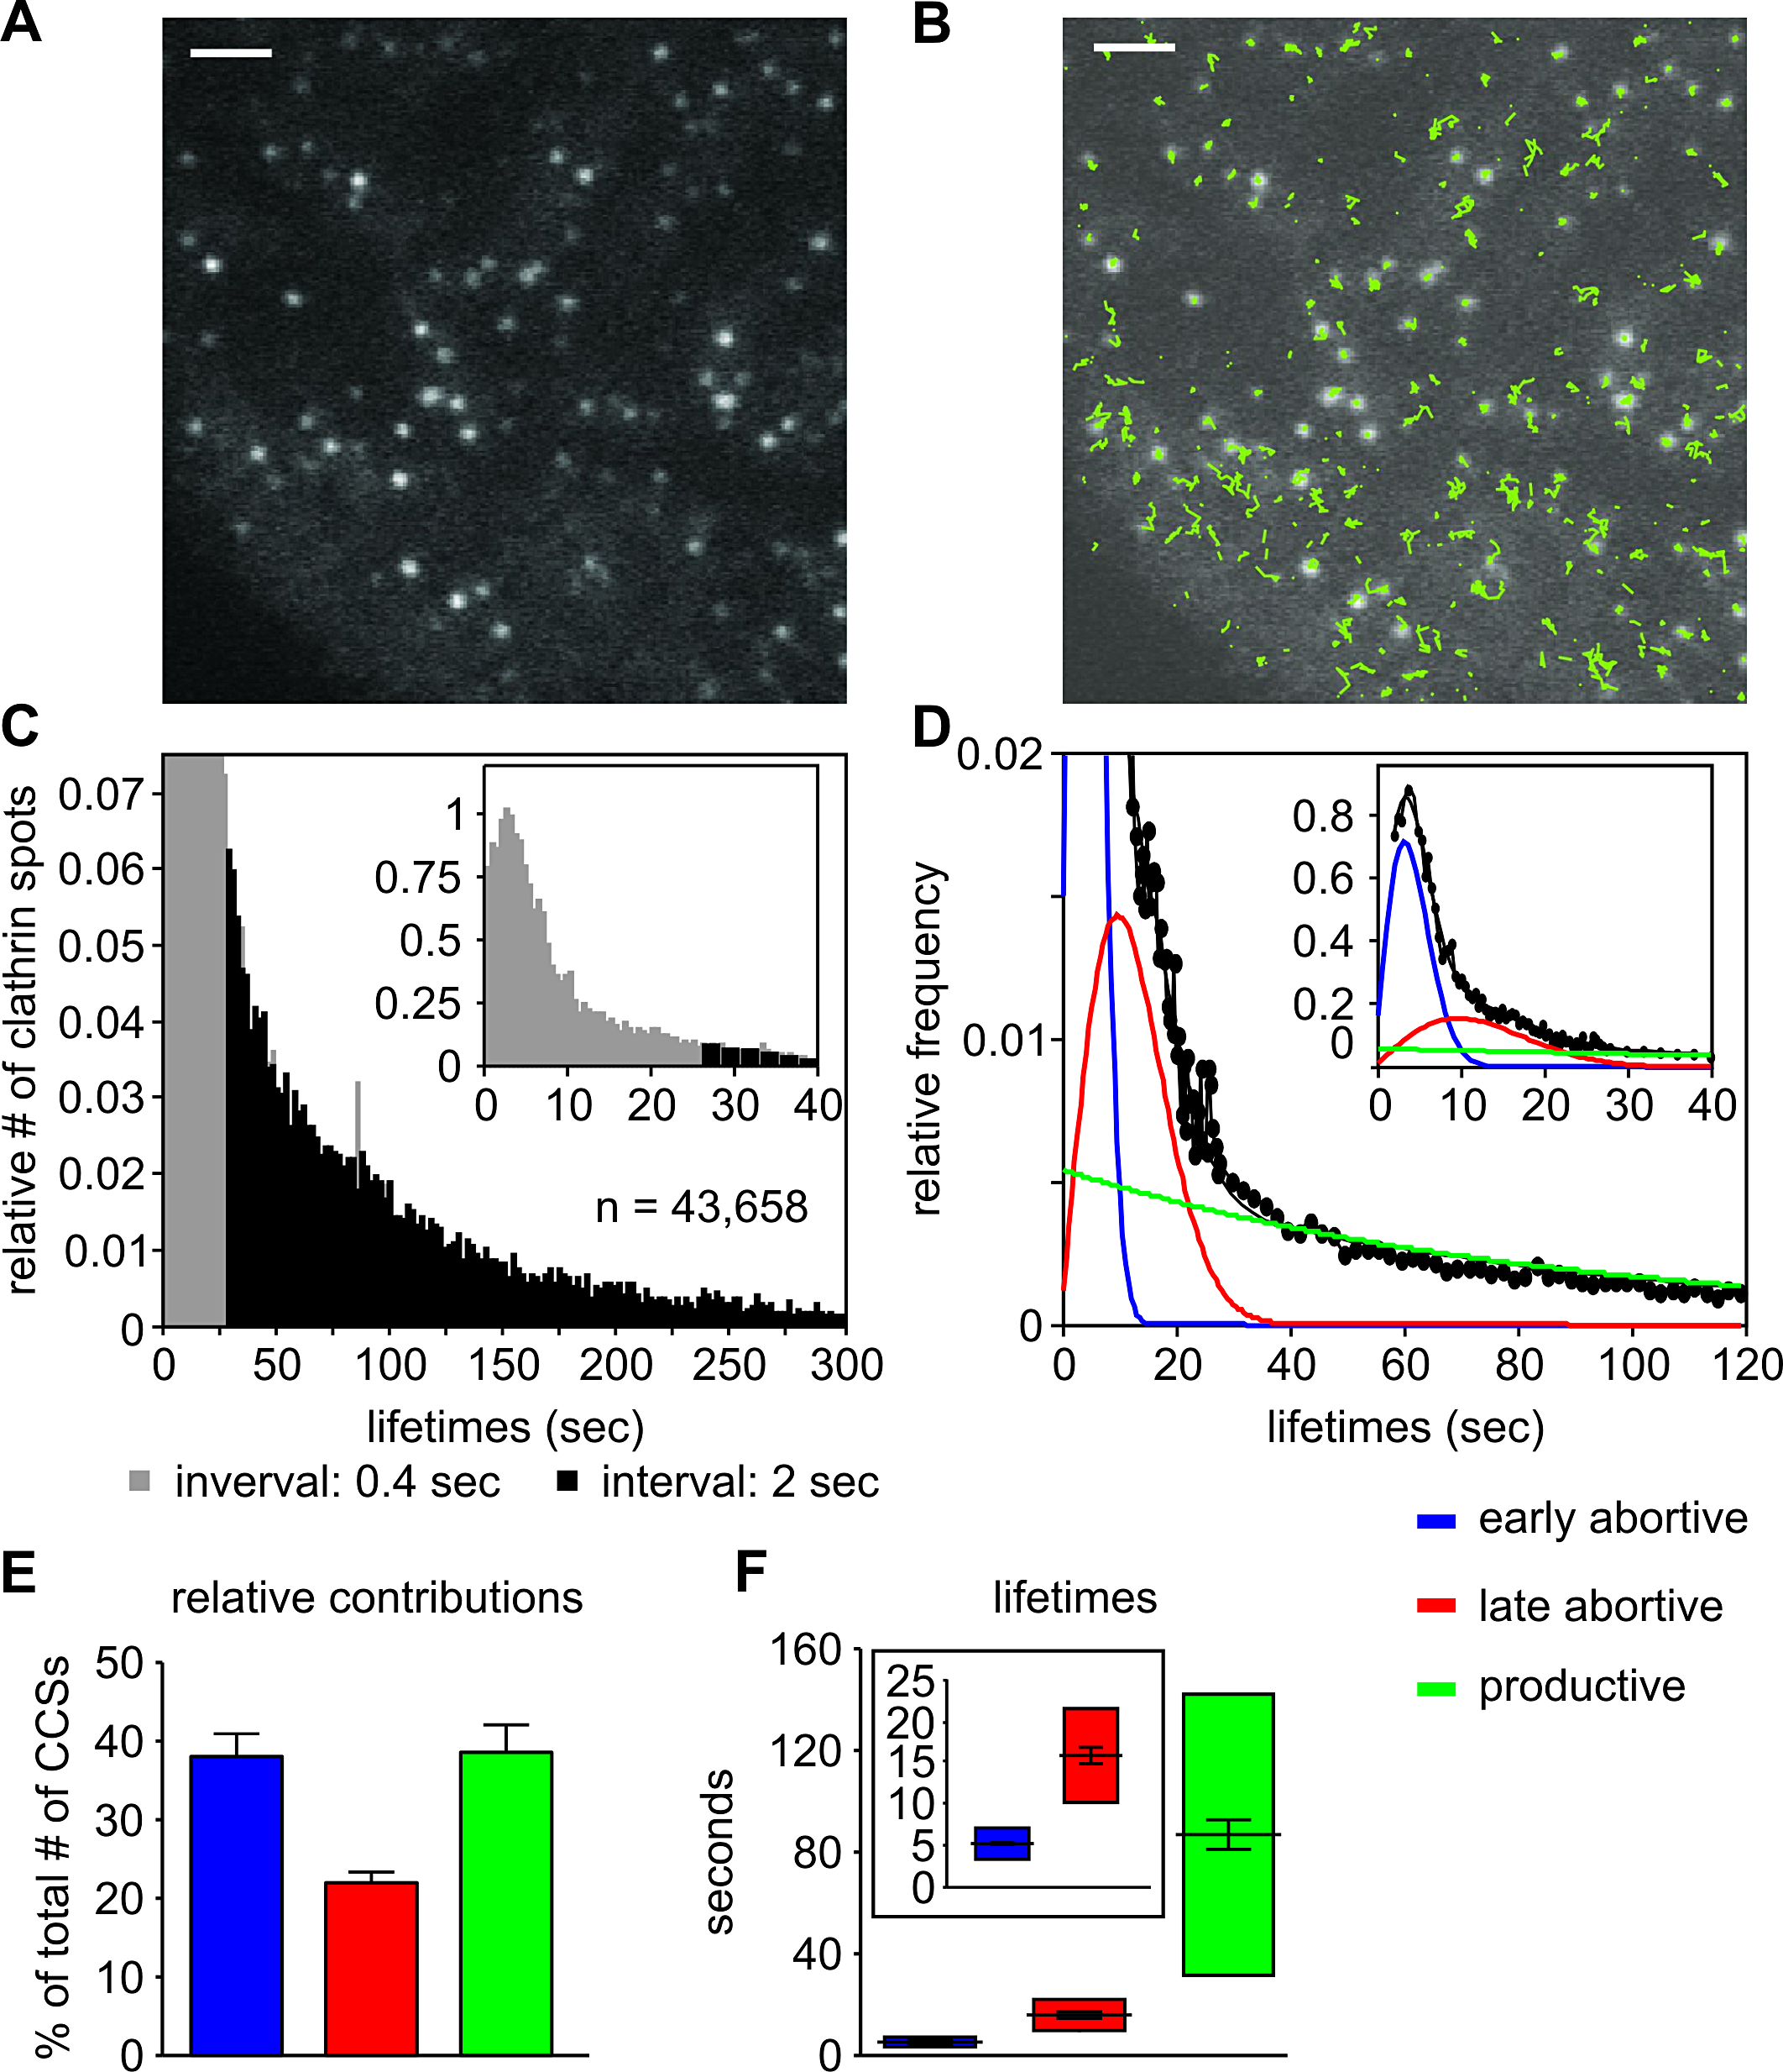
Aim: Analyze the lifetime of clathrin-coated pit by the exponential fitting
Tracking CCP
Exponential fitting
Analyze contribution and calculate the mean of lifetime
(Loerke D, Mettlen M, Yarar D, Jaqaman K, Jaqaman H, Danuser G, et al. (2009) Cargo and Dynamin Regulate Clathrin-Coated Pit Maturation. PLoS Biol 7(3): e1000057. )
Features:
The trajectories extracted by the tracking software fall into two different categories: trajectories that appear and disappear during the movie; and trajectories that are cut off by the beginning or end of the movie. Therefore, the observed track number was corrected by the probability.
CCP lifetimes range from a few seconds to several minutes. To fully capture this range of dynamics would require image sampling over minutes at a high frame rate. Such exposure leads to significant photobleaching and also substantially impairs cell viability. Two timescale imaging approach was applied by analyzing two datasets with different acquisition frame rates.

Slide 2
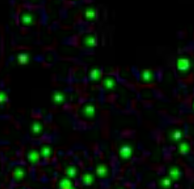
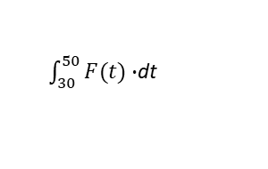

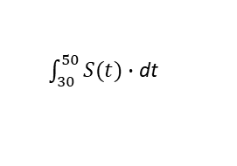
Fast Acquisition 0.643 sec/frame
Slow Acquisition 2.136 sec/frame
F_{img} ₁
F_{img 2}
S_{img} ₁
S_{img} ₂
Get observed tracks by Imaris
Get observed tracks by Imaris
F_{Track} ₁
F_{Track} ₂
S_{Track} ₁
S_{Track} ₂
Time Index
Track duration
Track no. of spots
Time Index
Track duration
Track no. of spots
Time Index
Track duration
Track no. of spots
Time Index
Track duration
Track no. of spots
Google Colab at hereimntuic@gmail.com
A_Get lifetime probability density function_20241226
Correct tracks by probability with Python script
Google Colab at hereimntuic@gmail.com
A_Get lifetime probability density function_20241226
Correct tracks by probability with Python script
F_{cf} _{Track 1}
F_{cf} _{Track 2}
S_{cf} _{Track 1}
S_{cf} _{Track 2}
Track duration
Measured Track no.
Correct factor
Corrected Track no.
Lite Time
Normalized Track population
Track duration
Measured Track no.
Correct factor
Corrected Track no.
Lite Time
Normalized Track population
Track duration
Measured Track no.
Correct factor
Corrected Track no.
Lite Time
Normalized Track population
Track duration
Measured Track no.
Correct factor
Corrected Track no.
Lite Time
Normalized Track population
Google Colab at hereimntuic@gmail.com
B_Merge tracks from the same acquisition speed.ipynb
Google Colab at hereimntuic@gmail.com
B_Merge tracks from the same acquisition speed.ipynb
Merge data from the same acquisition speed
Merge data from the same acquisition speed
Merged Fast F(t)
Merged Slow S(t)
Track duration
Corrected Track no.
Lite Time
Normalized Track population
Track duration
Corrected Track no.
Lite Time
Normalized Track population
$\int_{30}^{50}{F(t)}∙$dt
$\int_{30}^{50}{S(t)}$ $∙$dt
$$α=\frac{\int_{30}^{50}{S\left(t\right)∙dt}}{\int_{30}^{50}{F(t)}∙\text{dt}}$$

Slide 3
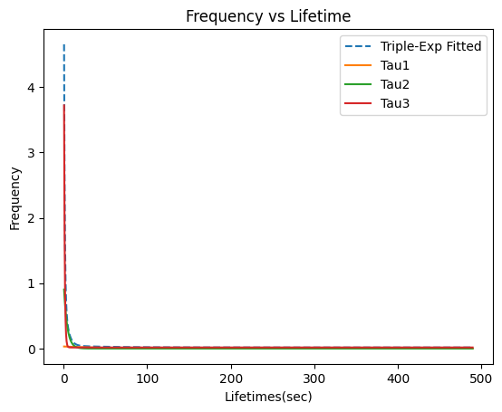
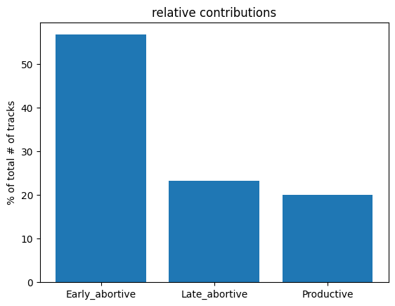
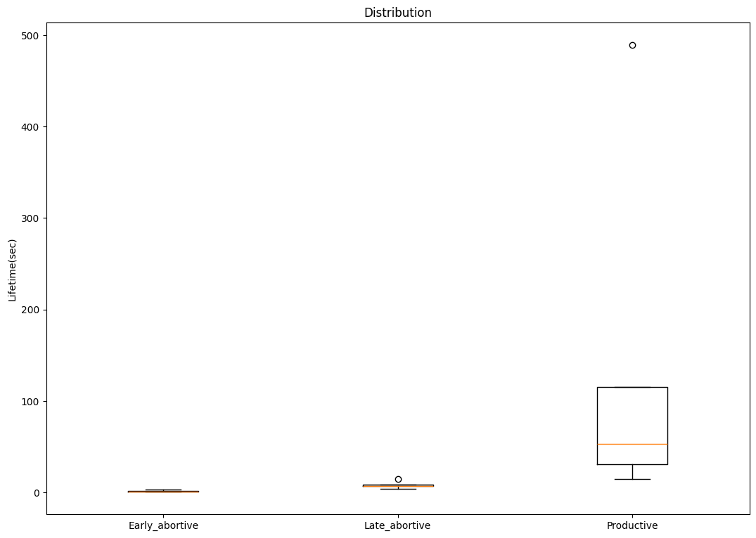





Google Colab at hereimntuic@gmail.com
C_Normalize Ft and St in Colab_20241229.ipynb
Data wrangling and Lifetime analysis
Column 1
Observed time point t
Column 2
Column 3
Column 4
Histogram merge
$tf=0.602, 1.204,…..,$t _{fmax} from F$\left(t\right)$
$$α∙F(t)$$
$$S(t)$$
$$α∙F\left(t\right)+S(t)$$
$ts=2.214, 4.428,…..,$t _{smax} from $S\left(t\right)$
Triple exponential fitting
Calculate crossing point
Classify trajectories
Calculate relative distribution
Box plot
↓ Lifetime mean

Slide 4
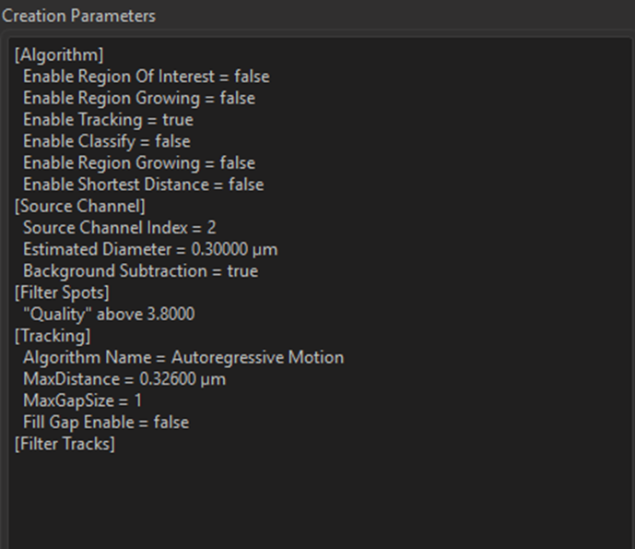
Parameters of Imaging and Tracking
Imaging with Zeiss Elyra7 TIRF
Zeiss Elyra7 TIRF
Pixel size 63*63 nm
Objective alpha Plan-Apo 63x/1.46 oil
At ~0.6 sec/ frame and 2 sec/frame
Tracking with Imaris
Change the frame speed to 1 sec/frame to simplify the calculation. This will be corrected in the Jupyter notebook analysis.
Image proc\ Gaussian 0.062

